Slide 1

Genetics
Chapter 6

Slide 2
Chromosomal Mutations
After this section you will be able to……
Compare chromosomal mutations with gene mutations
Identify types of chromosomal mutations and their effects
Identify chromosomal mutations by karyotyping

Slide 3
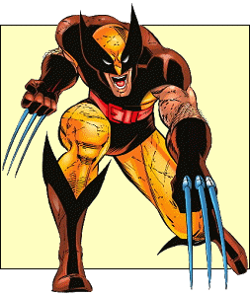
TEKS
B.6E identify and illustrate changes in DNA and evaluate the significance of these changes

Slide 4
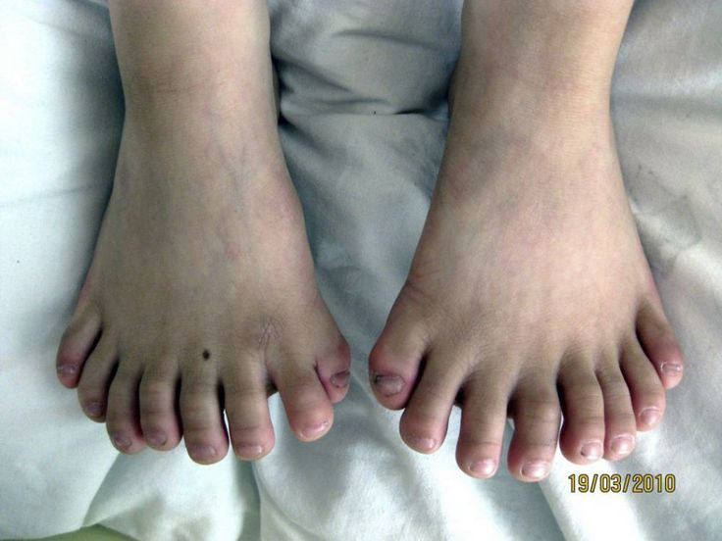
Mutations
Mutations are alterations to a DNA sequence. If one thinks of the information in DNA as a series of sentences, mutations are errors in spelling the words that make up those sentences.

Slide 5
Two categories
Gene mutations produce changes in a single gene
Chromosomal mutations produces changes in the number or structure of chromosomes. They include deletions, duplications, inversions, translocations and non-disjunction

Slide 6

Effects of Mutations
Genetic material can be altered by natural events or by artificial means. Errors can be made during replication.

Slide 7

Mutagens
Environmental conditions may increase the rate of mutation. Mutagens are chemical or physical agents in the environment that cause mutations.
Discuss with your table what could be considered mutagens. Write them down.

Slide 8
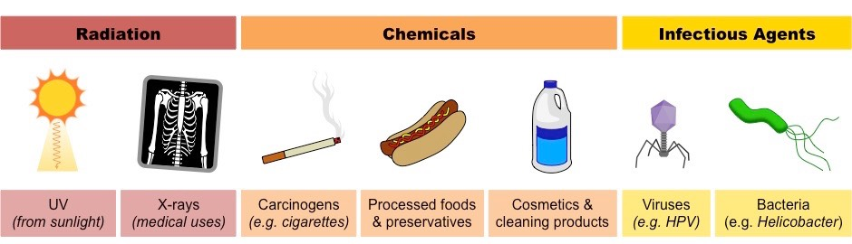
Mutagens

Slide 9

Effects of Mutations
Mutations can have little or no effect

Slide 10
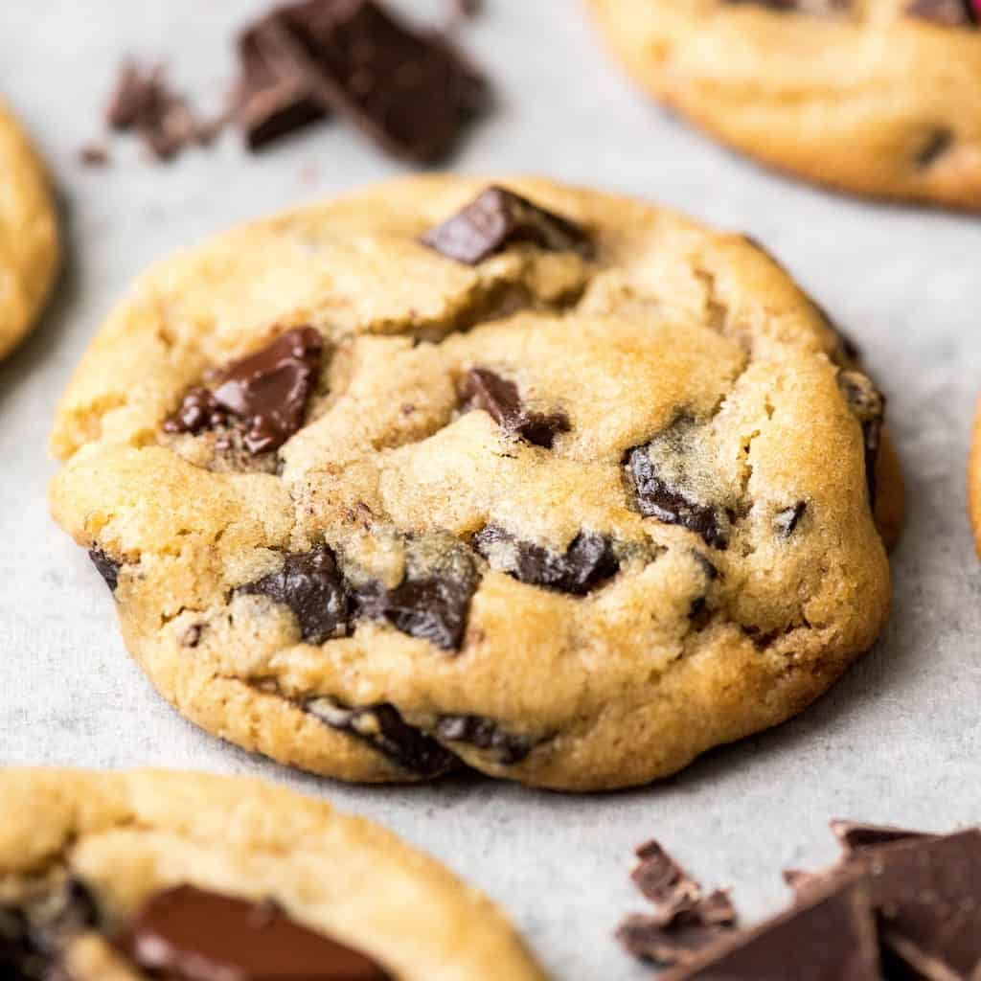
Cookie Recipe
Ingredients
1 cup salted butter* softened
1 cup white (granulated) sugar
1 cup light brown sugar packed
2 tsp pure vanilla extract
2 large eggs
3 cups all-purpose flour
1 tsp baking soda
½ tsp baking powder
1 tsp sea salt
2 cups chocolate chips (or chunks, or chopped chocolate)
Instructions
Preheat oven to 375 degrees F. Line a baking pan with parchment paper and set aside.
In a separate bowl mix flour, baking soda, salt, baking powder. Set aside.
Cream together butter and sugars until combined.
Beat in eggs and vanilla until fluffy.
Mix in the dry ingredients until combined.
Add 12 oz package of chocolate chips and mix well.
Roll 3 TBS of dough at a time into balls and place them evenly spaced on your prepared cookie sheets. (alternately, use a small cookie scoop to make your cookies)!
Bake in preheated oven for approximately 8-10 minutes. Take them out when they are just BARELY starting to turn brown.
Let them sit on the baking pan for 2 minutes before removing to cooling rack.

Slide 11
Cookie Recipe Mutation
Ingredients
1 cup salted butter* softened
1 cup white (granulated) sugar
1 cup light brown sugar packed
2 tsp pure vanilla extract
2 large eggs
3 cups all-purpose flour
1 tsp baking soda
½ tsp baking powder
1 tsp sea salt
2 cups chocolate chips (or chunks, or chopped chocolate)
Instructions
Preheat oven to 375 degrees F. Line a baking pan with parchment paper and set aside.
In a separate bowl mix flour, baking soda, salt, baking powder. Set aside.
Cream together butter and sugars until combined.
Beat in eggs and vanilla until fluffy.
Mix in the dry ingredients until combined.
Add 12 oz package of chocolate chips and mix well.
Roll 3 TBS of dough at a time into balls and place them evenly spaced on your prepared cookie sheets. (alternately, use a small cookie scoop to make your cookies)!
Bake in preheated oven for approximately 9-10 minutes. Take them out when they are just BARELY starting to turn brown.
Let them sit on the baking pan for 2 minutes before removing to cooling rack.

Slide 12
Cookie Recipe Mutation
Ingredients
1 cup salted butter* softened
1 cup white (granulated) sugar
1 cup light brown sugar packed
2 tsp pure vanilla extract
2 large eggs
3 cups all-purpose flour
1 tsp baking soda
½ tsp baking powder
1 tsp sea salt
2 cups chocolate chips (or chunks, or chopped chocolate)
Instructions
Preheat oven to 675 degrees F. Line a baking pan with parchment paper and set aside.
In a separate bowl mix flour, baking soda, salt, baking powder. Set aside.
Cream together butter and sugars until combined.
Beat in eggs and vanilla until fluffy.
Mix in the dry ingredients until combined.
Add 12 oz package of chocolate chips and mix well.
Roll 3 TBS of dough at a time into balls and place them evenly spaced on your prepared cookie sheets. (alternately, use a small cookie scoop to make your cookies)!
Bake in preheated oven for approximately 8 - 10 minutes. Take them out when they are just BARELY starting to turn brown.
Let them sit on the baking pan for 2 minutes before removing to cooling rack.

Slide 13

Effects of Mutations
Some mutations can produce beneficial variations

Slide 14
Decode the following message.
Codon | Codes for
AAA | a cat
AUC | ate
CAG/ CAC | brown
CCG | dog
GUA | is
GCG | my
UGG | old
UGA | STOP
C G C G G C C A T G T C
G C G C C G G U A C A G
My dog is brown

Slide 15
Decode the following message.
Codon | Codes for
AAA | a cat
AUC | ate
CAG/ CAC | brown
CCG | dog
GUA | is
GCG | my
UGG | old
UGA | STOP
C G C G G C C A T G T C
Change your code based on your assigned group and decode again.
Group 1 - Change the last C to a G.
C G C G G C C A T G T G
G C G C C G G U A C A C
My dog is brown

Slide 16
Decode the following message.
Codon | Codes for
AAA | a cat
AUC | ate
CAG/ CAC | brown
CCG | dog
GUA | is
GCG | my
UGG | old
UGA | STOP
C G C G G C C A T G T C
Change your code based on your assigned group and decode again.
Group 2 - Remove the last 3 bases. Replace them with TTT.
C G C G G C C A T T T T
G C G C C G G U A A A A
My dog is a cat

Slide 17
Decode the following message.
Codon | Codes for
AAA | a cat
AUC | ate
CAG/ CAC | brown
CCG | dog
GUA | is
GCG | my
UGG | old
UGA | STOP
C G C G G C C A T G T C
Change your code based on your assigned group and decode again.
Group 3 - Move the A between the two Cs.
C G C G G C A C T G T C
G C G C C G U G A A A A
My dog STOP

Slide 18
Decode the following message.
Codon | Codes for
AAA | a cat
AUC | ate
CAG/ CAC | brown
CCG | dog
GUA | is
GCG | my
UGG | old
UGA | STOP
C G C G G C C A T G T C
Change your code based on your assigned group and decode again.
Group 4 - Remove the last 3 bases. Replace with ACC.
C G C G G C C A T A C C
G C G C C G G U A U G G
My dog is old

Slide 19
Decode the following message.
Codon | Codes for
AAA | a cat
AUC | ate
CAG/ CAC | brown
CCG | dog
GUA | is
GCG | my
UGG | old
UGA | STOP
C G C G G C C A T G T C
Change your code based on your assigned group and decode again.
Group 5 - Remove the last 6 bases. Replace with TAG TTT.
C G C G G C T A G T T T
G C G C C G A U C A A A
My dog ate a cat

Slide 20
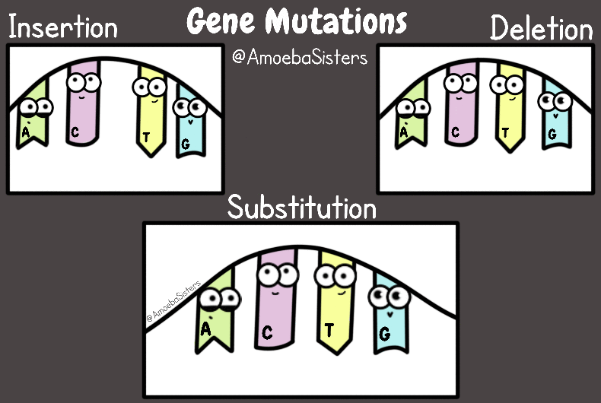
Types of mutations
Substitution (point mutation)
Insertion (frameshift)
Deletion (frameshift)
Inversion

Slide 21
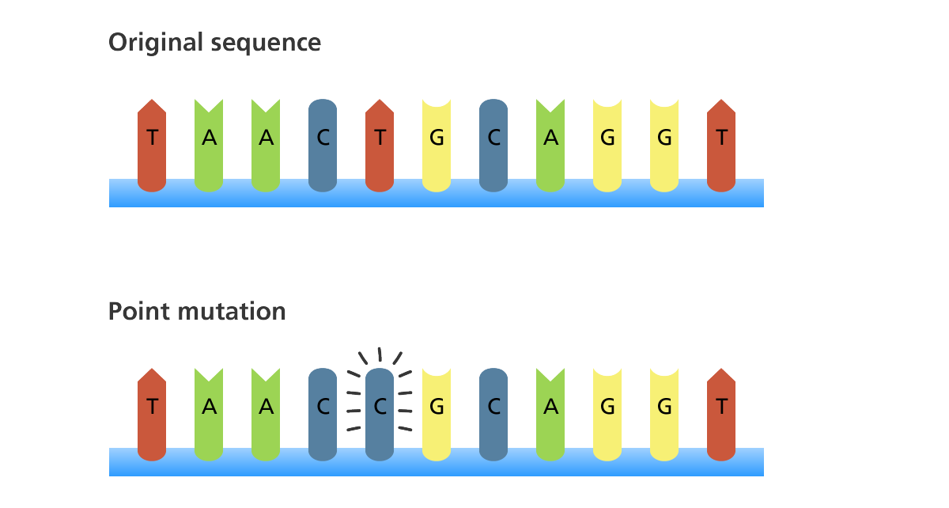
Substitution (Point mutation)

Slide 22
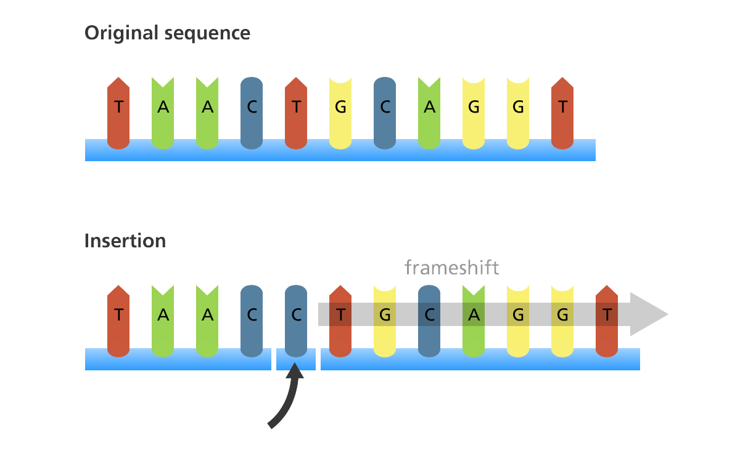
Insertion (Frameshift)

Slide 23
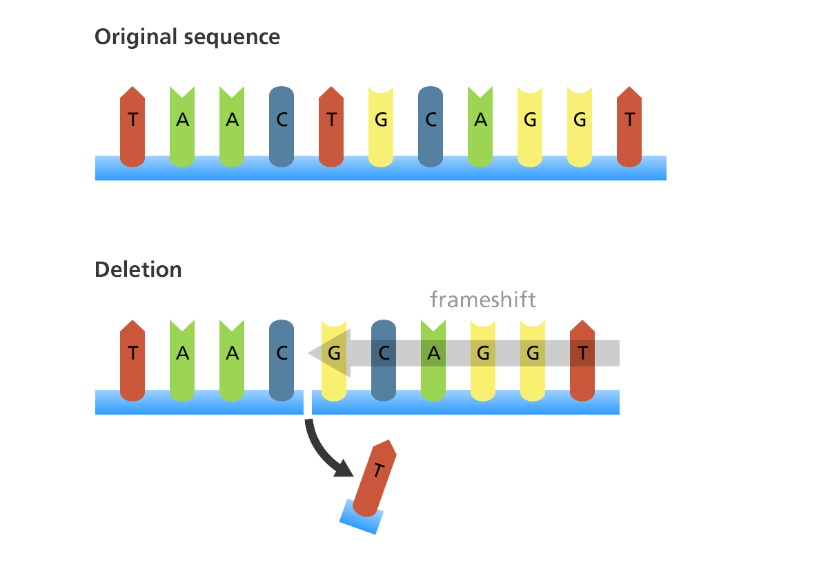
Deletion (Frameshift)

Slide 24
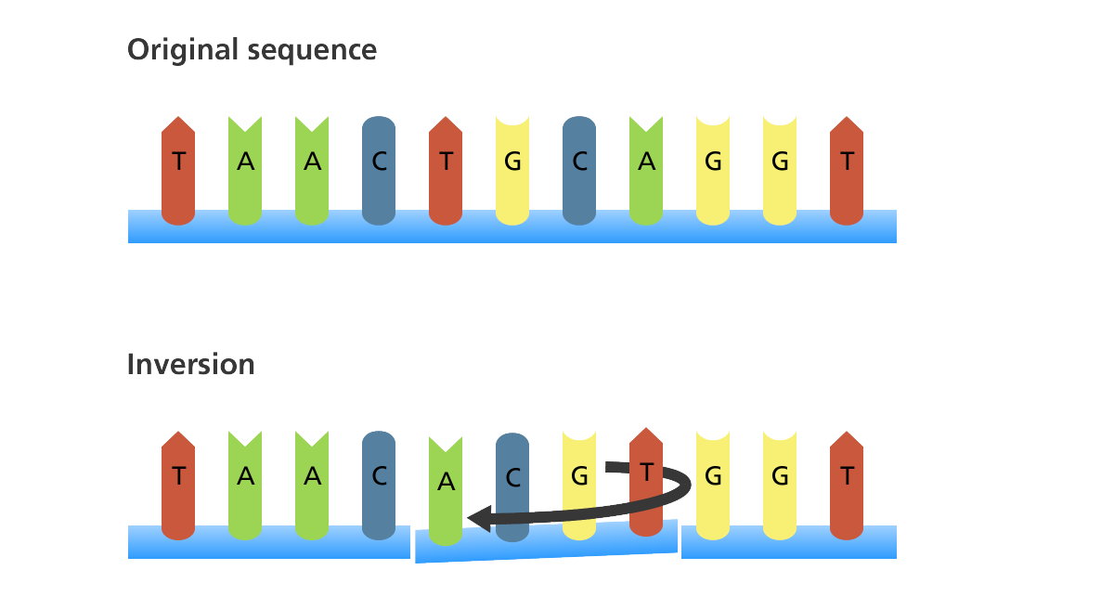
Inversion

Slide 25
What type of mutations are these?
Original
Mutation 1
Mutation 2
G A T T T A
G A A T T A
G C T T T A
C U A A A U
C U U A A U
C G A A A U
Leu Asn
Leu Asn
Arg Asn
No change/ silent mutation
1 amino acid change

Slide 26
What type of mutation is this?
Original
Mutation 1
C A C T T T G G T
C A C A T T T G G T
G U G A A A C C A
G U G U A A A C C A
Valine-Lysine-Proline
Valine-STOP

Slide 27
What type of mutation is this?
Original
Mutation 1
C A C T T T G G T
C C T T T G G T
G U G A A A C C A
G G A A A C C A
Valine-Lysine-Proline
Glycine-Threonine

Slide 28
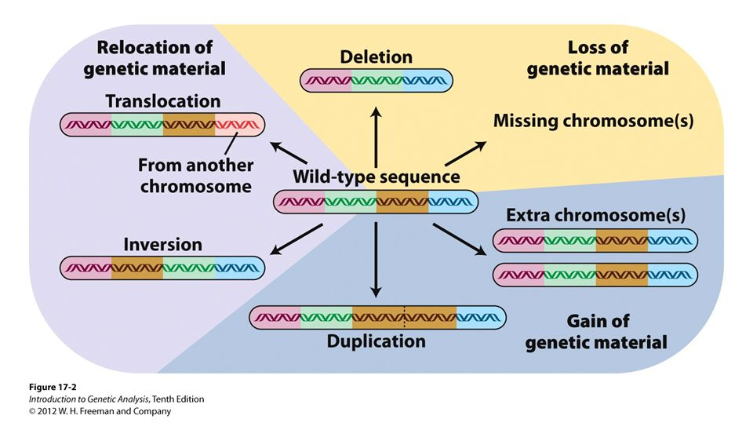
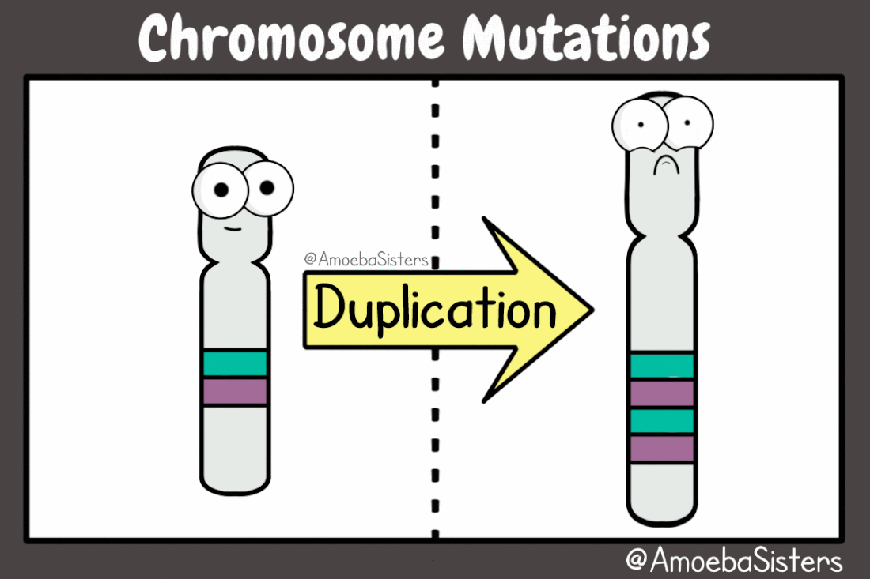
Chromosomal Mutations
Duplication
Deletion
Translocation
Inversion

Slide 29
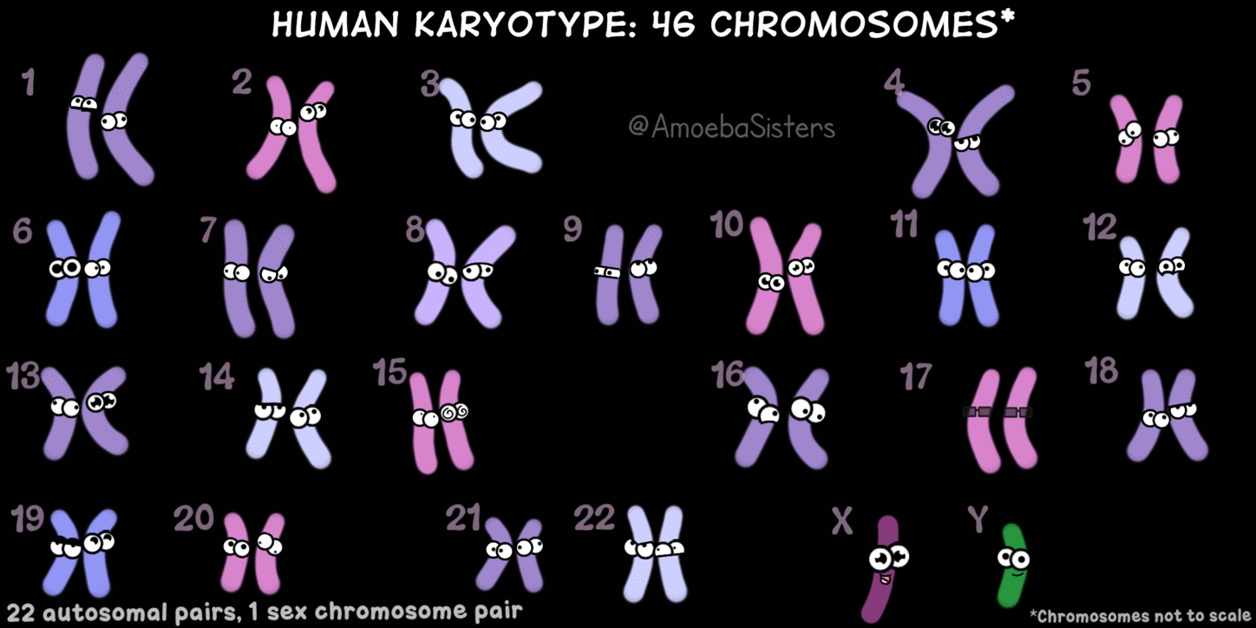
Karyotyping
When homologous chromosomes fail to separate properly during meiosis we call this process nondisjunction. These types of mutations can be identified by karyotyping.

Slide 30
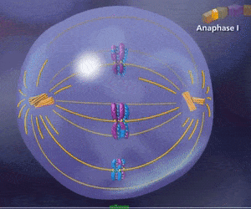
Nondisjunction
This is a normal cell undergoing meiosis I. What might happen in order for nondisjunction to occur?

Slide 31
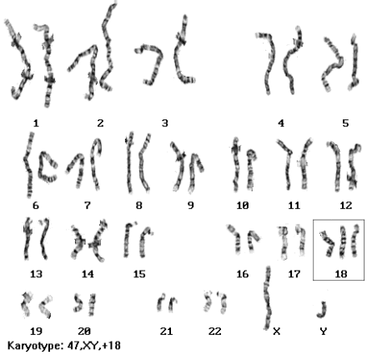
Karyotyping
Trisomy 18, also known as Edward’s Syndrome, occurs when there is an extra 18 chromosome exists. A Trisomy 18 error occurs in about 1 out of every 2500 pregnancies in the United States and 1 in 6000 live births..

Slide 32
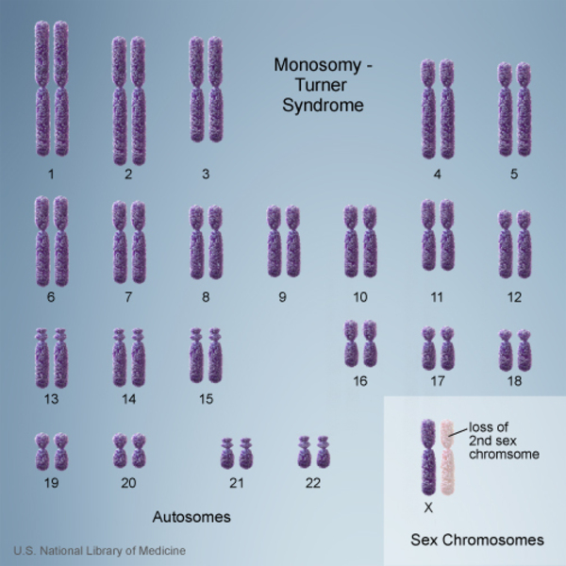
Karyotyping
Turner’s syndrome is a loss of the second X chromosome in females. Sometimes, the chromosome may be present, but incomplete. Turner syndrome can cause a variety of medical and developmental problems, including short height, failure of the ovaries to develop and heart defects. Since there is a missing chromosome, we call this monosomy X.

